Slide 1

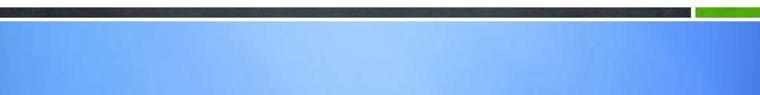
MODULE-8
SERVLETS

Slide 2
Course Topics
→ Module 1
» Introduction to Java
→ Module 8
» Servlets
→ Module 2
» Data Handling and Functions
→ Module 9
» JSP
→ Module 3
» Object Oriented Programming in Java
→ Module 10
» Hibernate
→ Module 4
» Packages and Multi-threading
→ Module 11
» Spring
→ Module 5
» Collections
→ Module 12
» Spring, Ajax and Design Patterns
→ Module 6
» XML
→ Module 13
» SOA
→ Module 7
» JDBC
→ Module 14
» Web Services and Project

Slide 3
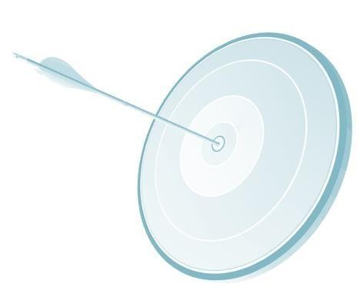
Objectives
At the end of this module, you will be able to:
→ Understand Client Server Architecture
→ Understand Server types
→ Use Http and its methods
→ Understand servlet types and exceptions
→ Implement servlets
→ Understand and Implement Session Tracking
→ Use Filters

Slide 4


Internet
Internet is global system of interconnected computers which uses standard protocol TCP/IP which
connects billions of computers across the world.

Slide 5

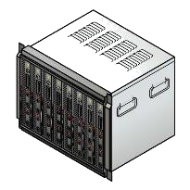


Client Server Technology
Client
→ In the client server technology, client requests for a service. This request is reached to server through TCP/IP.
Response
→ Upon receiving the request server interprets the request and provides the required service to the client.
→ Server and client can be on the same machine.
Query
Search
DATA
→ Server and client can be in different machines. In this case, Server can serve many clients at a time.
Server

Slide 6

Annie’s Question
Can you give a practical example of Client Server Technology?

Slide 7
Annie’s Answer
One printer can be connected to many computers. This printer server will print from all the computers when requested for.

Slide 8

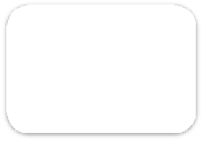



Web Technology
→ Client sends the request to the server on internet.
→ Client uses HTTP protocol to send the request.
Request
Client
Server
HTTP
Response

Slide 9


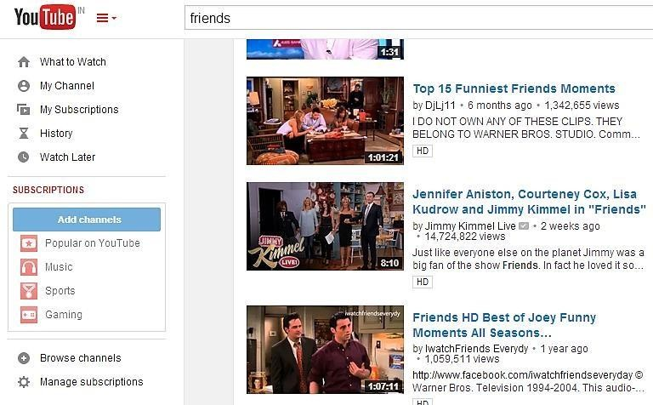
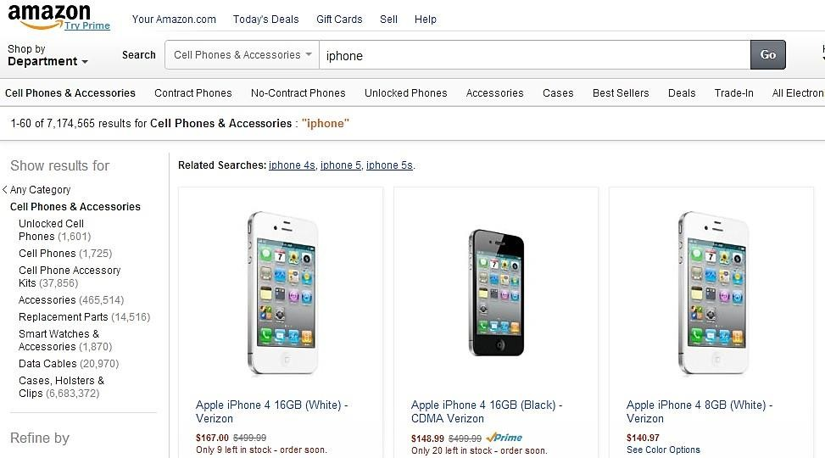
Web Technology - Example
YouTube, Amazon.com etc., uses web technology. When the user logs into this site and clicks on the selected item, server recognizes what the user/client needs and responds to the client request by displaying the desired information/image/page.

Slide 10

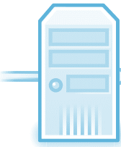


Internet Server
Browser is a client which sends the request to the server. This request is transmitted on internet to the server.
Server is a software which receives the request and passes it on to the corresponding program running on the server software.
Internet
For example, we can login to google server and select any program of the google like gtalk, Gmail, blog, translator etc., based on our request, google server will call the corresponding program.
Server

Slide 11

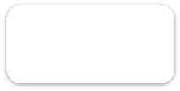

Client - Server Architecture of the Internet
http://domain.com/page.html
Client request
Browser
Content of page .html or error code
Server response

Slide 12
Server Types
There are two types of servers:
→ Web server
→ Application server
Web server takes the http request and responds to the client. Some of the web servers are Apache
Tomcat, IIS etc.
Application server is an extension of Web server. In addition to the web server, it provides the following facilities:
→ Load balancing
→ Resource management (Connection pooling)
→ State management
Some of the Application servers are Jboss, Web Logic, Web Sphere, GlassFish etc.

Slide 13

HTTP
HTTP stands for Hyper Text Transfer Protocol.
Standard HTTP port is 80.
HTTPS stands for HTTP + Secured
If the client/browser uses https protocol then data from the client/browser will be encrypted and sent on internet to the server. Server decrypts the data, interprets and serves the client.

Slide 14
HTTP - Methods
Some of the HTTP methods are:
→ GET – To retrieve information from the given server.
→ HEAD – Same as GET but transfers only header section.
→ POST – For sending the data to the server.
→ DELETE – To delete a resource.
→ PUT – The PUT method requests that the enclosed entity be stored under the supplied Request- URI.
→ TRACE – The TRACE method is used to invoke a remote, application-layer loop-back of the request message.
→ CONNECT – This specification reserves the method name CONNECT for use with a proxy that
can dynamically switch to being a tunnel.

Slide 15
Difference between GET and POST
GET | POST
GET will display parameters as part of URL. | POST will send the user's data/parameters as part of request body.
GET is used to send Text information. | POST can be used to send large files and BLOB also.
DoGet() is used for GET. | DoPost() will be used for POST at server side.
GET is less secured as it is seen in URL | POST is secured as it will be sent as part of Request body.
GET URL can be stored in browser history. | POST will not be stored in browser history.

Slide 16
Where and How do we use GET and POST?
Where do we use GET and POST?
All places where the client data needs to be sent to the server on Internet, GET and POST
methods can be used.
How do we use GET and POST?
When GET or POST is used, the client data is transmitted on internet and will be sent to the server. Server receives data in Request object. Request object content is extracted to get the data given by the client.

Slide 17

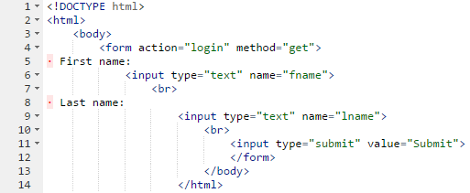
GET - Example
→ This HTML code displays First Name and Last Name edit boxes and submit button.
→ When the submit button is clicked, data entered in first name and last name will be sent to the server as part of URL and will execute login servlet.

Slide 18

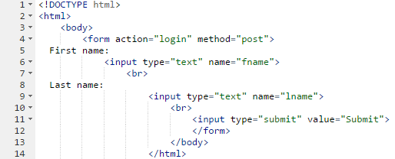
Post - Example
Above HTML code works similar to previous HTML code but only the difference is method of sending the data from client is using POST rather than GET.
This will send the client data in the message body rather than as part of URL.

Slide 19
Annie’s Question
Can you think of one practical scenario where GET and POST is required?

Slide 20
Annie’s Answer
POST is used when we need to send confidential data. For example, entering login information in gmail, POST can be used. GET is used in all other cases.

Slide 21
Servlet

Slide 22
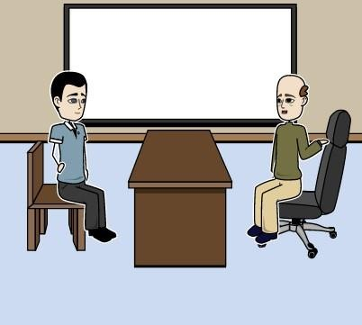
John to Program Processes…
John, I want to go for the server side programming for the processes in the HR department. How do you think we can go ahead with this?

Slide 23
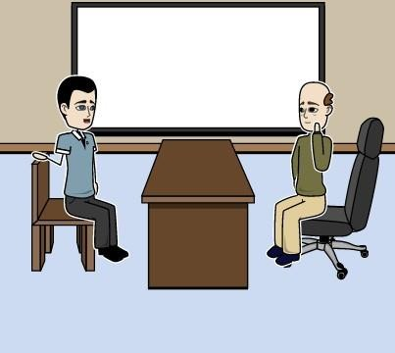
John to Program Processes…
Sir, we can use Servlet programs. We can develop the screen using HTML. For the computation we can use Servlet programming.
Also, we can use Mysql server as the RDBMS and connect it with Servlets.

Slide 24
John to Program Processes…
What are servlets?

Slide 25
John explains Servlet
Servlet is a Java technology to create dynamic web pages.

Slide 26
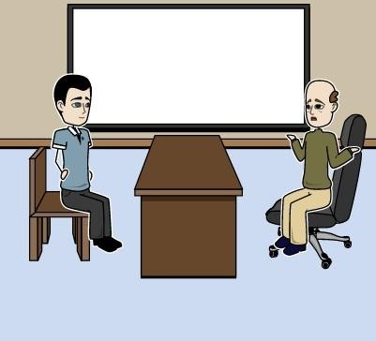
Why Servlets?
But why servlets when we have CGI?

Slide 27
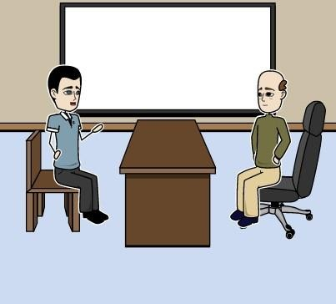
Why Servlets?
In CGI, for each new request a new process has to be created.
With this memory consumption becomes more and the performance of the system goes down. To avoid this issue Java came up with servlets.

Slide 28
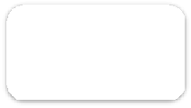







What is a Servlet?
Web Server
→ Servlet is a Java technology to create dynamic web pages.
Client
Data Source
→ Servlet is a web component which is deployed on a web server/app server to create dynamic web pages.
Request
Response
Servlet
→ When the client sends the request, server receives it and sends to the corresponding servlet program. Servlet program interprets the request and responds accordingly.
JDBC Connection

Slide 29
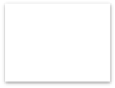




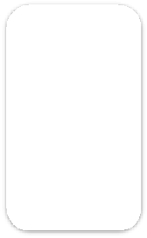



Why Servlets are used over CGI?
For every request from the client a new CGI program is created in the server system. With this the memory consumption is very high and performance level is very low. There are high chances of system crash too.
Server
CGI
Shell
CGI
Program
Request Request Request
CGI
Shell
CGI
Shell
Processor load
h t t p d

Slide 30





Why Servlets are used over CGI? (contd.)
To resolve this issue, servlets are used. Servlet engine or web server creates a new thread for each client request instead of creating a new program for every request.
Web Server
Web Container
Thread
Request
Request
Thread
Servlet
Request
Thread
Processor load

Slide 31
Annie’s Question
What benefit we will get if a new thread is created for each
request rather than creating a new program for each request?

Slide 32
Annie’s Answer
When a new thread is created for each request, memory is saved and server can serve many clients and performance of the project is very good.

Slide 33









Servlet Life Cycle
Instantiate
& call init()
After the servlet program is done, it has to be deployed in Apache tomcat.
called once
init()
When the tomcat comes up, servlet is loaded in the memory. At this time init() method is called.
Ready to serve
requests
Thread 1: client request
Thread 2: client request
service()
This is for initializing the attributes of the servet. It is like constructor.
Handle multiple requests and
Thread 3: client request
send response
Service(), when any client request comes service() method is invoked.
called once
destroy()
Destroy() method is called when servlet is about to be removed from memory.

Slide 34
Servlet
→ Servlet is a interface.
→ Servlet interface provides init(), service() and destroy() method to implement.
→ GenericServlet() implements servlet interface.
→ HttpServlet extends GenericServlet and provides HTTP methods like get, post etc.

Slide 35






Servlet Types
Servlet
GenericServlet
HTTPServlet
MyServlet

Slide 36
Servlet Configuration with Eclipse
Download Apache tomcat 7.0
Open Eclipse → Click on Window menu → Preferences → Server → Runtime Environment → Add
→ Select the tomcat version 7.0 → provide the directory of tomcat installed directory → ok.

Slide 37

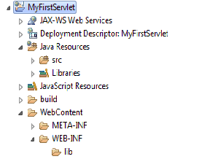
Project Creation in Eclipse
Ensure you are on J2EE perspective.
Click on File → New → Dynamic Web Project.
Enter the name of the project and click on finish.
If the project name is given as MyFirstServlet, Eclipse will create the following directories by default:

Slide 38
Information on Directories of Servlet Project
Src → To place Java/servlet files.
WebContent → To place html and jsp files.
WEB-INF → to place xml files.
Lib → All the libraries which are required for the project.

Slide 39
Annie’s Question
What is the difference between HTML and XML?

Slide 40
Annie’s Answer
XML carries the data and HTML displays the data.

Slide 41
Servlet Exception
Servlet has the following two exceptions:
ServletException: Defines a servlet exception that a servlet throws while processing the client request.
UnavilableException: Defines a servlet exception that is thrown by a servlet, when a servlet is unavailable.

Slide 42

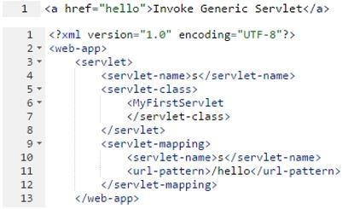
Servlet Program

Slide 43

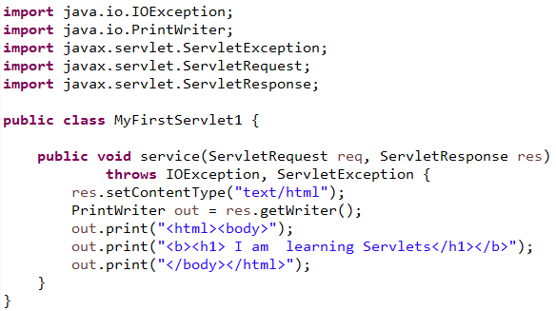
GenericServlet Program

Slide 44
Explanation of Generic Servlet Program
Index.html provides a hyperlink.
In Web.xml,
→ first you need to check <servlet-mapping>
→ <url-pattern> is mapped to a <Servlet-name>
→ Here when /hello is mapped to Servlet by name Name
Next look at <servlet> section. Here servlet name is mapped to servlet class. Here S is mapped to the class MyFirstServlet.
The program understands like this: URL Pattern → Servlet Name → Servlet Class...
Hence when /hello is given as part of URL, it executes MyFirstServlet.java class.

Slide 45
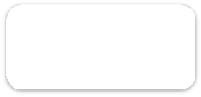







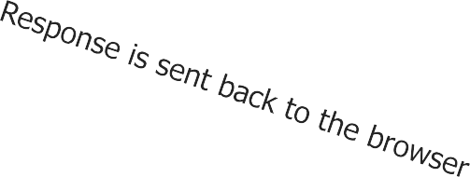

Forward and include of RequestDispatcher
Forward() Method
Forward
Servlet 1/JSP
Servlet 2/JSP
Client
Response is generated
Response
Response

Slide 46


Request Dispatcher Example
Dispatcher will load welcome servlet and forwards the control to it.
RequestDispatcher will load login.html and includes in the current page.

Slide 47


SendRedirect
SendRedirect() will redirect the control to a servlet/jsp/html.
This code will take a search string and fires the query to google.com and displays the result on
screen.

Slide 48
Session Tracking
It is required for a server to know the user and needs to maintain the state of the user as server will be addressing/serving multiple clients. For example, which user has logged in.
Knowing the user's information is called session tracking. There are 4 ways for session tracking:
→ Cookies
→ URL Rewriting
→ Hidden form field
→ HttpSession object

Slide 49


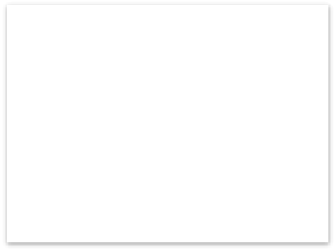


Session Tacking – Cookies
“Cookies” is a small piece of information which is stored on client by the server.
Advantages: Maintained at client side.
Dis-advantages: Can’t be used if browser disables the cookies.
3) request+cookie
1) request
Server
1) response+cookie

Slide 50
Session Tacking – URL Rewrite
Parameter Parameter name value
URL Parameter 1 Parameter 2
In URL Rewriting method, we append the user's data and call the next servlet. It is like
Http://localhost:8080/MyServlet?name=”james”
We are calling MyServlet by name James as the parameter for the field name.
Advantages: This method still works even when the cookies are disabled.
Dis-advantages: It can only text information.

Slide 51
Session Tracking: Hidden form Fields
This session tracking method uses Hidden keyword of HTML to send the information to the
next servlet.
Advantages: This method will work even if the cookies are disabled.
Dis-advantages: To send the data to an another servlet, we need to have an extra form to be
submitted.

Slide 52
Session Tracking – HttpSession
This session tracking method uses HttpSession object to store the state of the user.
HttpSession session=request.getSession();
session.setAttribute("name",”Alex”);
The above given code will gets the current session and stores in the session Object.
SetAttribute() is used to store the name Alex in the variable name.
In the entire session, we can use session.getAttribute(“name”), it will return the name Alex. HttpSession is one of the best method to store the user's information.

Slide 53

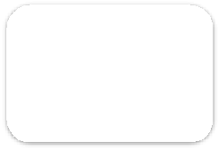








Filters
→ Filters are used to filter the data before actual processing begins.
→ Filters can be used for pre-processing and post-processing.
→ Filters are used for input validation, encryption/decryption, logging etc.
→ When a client sends request to the server with some data, control first goes to filters. Filters perform the necessary task in doFilter() and then forwards the control to another filter or a servlet.
Request
Request
Response
Response
Client
SimpleFilter.java
SimpleServlet.java

Slide 54
Features of Filters
→ Authentication and Authorization.
→ Logging information into the log files.
→ Compression and decompression before passing the data to the actual servlet.

Slide 55

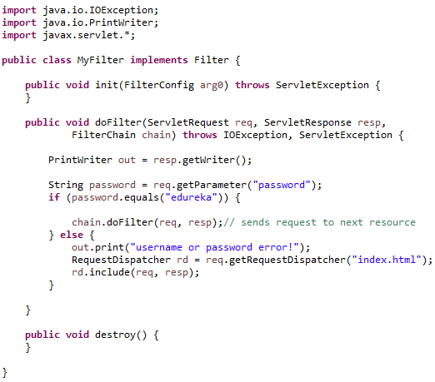
Example: Filters

Slide 56

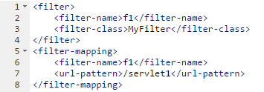
Code Explanation
Like servlet mapping in web.xml, filter mapping also has to be provided as given below:
Before the servlet gets executed, doFilter() of MyFilter.java will be executed.
In doFilter(), user password which is given by the user is checked with edureka. If the password is edureka then control is forwarded to the next resource else login page is displayed to the user to re- enter the valid user id and password.

Slide 57

QUESTIONS

Slide 58

Assignment
→ Develop login screen using HTML. When the user clicks on submit button validate the user id and password using filters.
If it is invalid id or password then display the login screen else display a servlet with given user id and password. If the user id and password is valid then store the user id as cookie on the client side.

Slide 59

Agenda for the Next Class
In the next module, you will be able to:
→ Understand JSP and its Architecture
→ Understand and Use JSP tags ( Scripts, declarative, expression)
→ Use Implicit Objects
→ Implement JSP Directives
→ Use JSP and JDBC together

Slide 60
Survey
Your feedback is important to us, be it a compliment, a suggestion or a complaint. It helps us to make
the course better!
Please spare few minutes to take the survey after the webinar.

Slide 61



